Slide 1

TNMT Retail Sales Report
FredFort Consulting Excel Project – Open Data Analytics

Slide 2
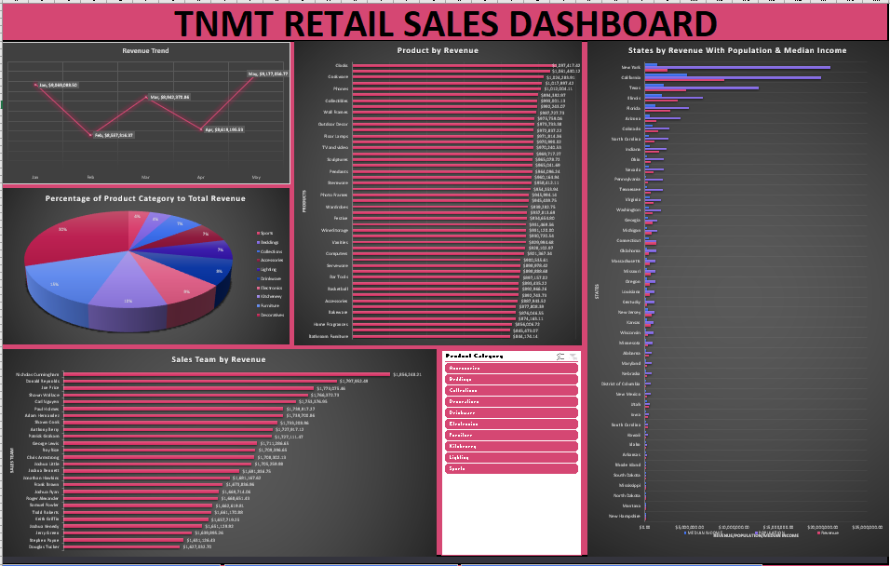

Slide 3

Revenue Trend
FredFort Consulting Excel Project – Open Data Analytics

Slide 4
Revenue Trend Chart
This was plotted using Sales by Month per Revenue

Slide 5
Table
Sales by Month | Sum of Revenue
January | $9,069,088.50
February | $8,557,316.37
March | $8,942,370.86
April | $8,619,195.53
May | $9,177,056.77
Grand Total | $44,365,028.02

Slide 6
Product by Revenue
FredFort Consulting Excel Project – Open Data Analytics

Slide 7
Product by Revenue Chart
This was plotted using Product per Revenue

Slide 8
Table
Products | Sum of Revenue
Bathroom Furniture | $844,174.14
Blankets | $845,473.07
Home Fragrances | $856,006.72
Baseball | $874,163.11
Bakeware | $876,046.55
Dinnerware | $877,808.39
Accessories | $887,943.52
Furniture Cushions | $892,743.73
Basketball | $892,966.26
Audio | $893,435.22
Bar Tools | $897,157.02
Wreaths | $898,888.68
Serveware | $898,978.42
Wall Coverings | $900,535.61
Computers | $921,367.34
Table Linens | $928,102.97
Vanities | $929,994.68
Outdoor Furniture | $930,720.54
Wine Storage | $931,120.00
Floral | $931,469.56
Festive | $934,654.80
Candleholders | $937,813.69
Wardrobes | $939,282.75
Platters | $945,439.75
Photo Frames | $945,994.14
Bedroom Furniture | $954,353.94
Stemware | $958,412.11
Cocktail Glasses | $960,164.94
Pendants | $964,096.24
Mirrors | $965,041.69
Sculptures | $965,078.72
Bean Bags | $969,717.27
TV and video | $970,240.53
Pillows | $970,990.02
Floor Lamps | $971,814.36
Dining Furniture | $972,837.22
Outdoor Decor | $973,733.38
Rugs | $975,759.06
Wall Frames | $987,727.73
Table Lamps | $992,243.07
Collectibles | $993,001.13
Candles | $994,392.97
Phones | $1,012,004.11
Ornaments | $1,017,997.42
Cookware | $1,024,283.91
Vases | $1,061,440.12
Clocks | $1,097,417.42
Grand Total | $44,365,028.02

Slide 9
Product Category Contribution to Revenue
FredFort Consulting Excel Project – Open Data Analytics

Slide 10
Product Category Contribution to Revenue Chart
This was plotted using Product Category (%) to Revenue

Slide 11
Table
Product Categgory | Sum of Revenue
Sports | 4%
Beddings | 4%
Collections | 7%
Accessories | 7%
Lighting | 7%
Drinkware | 8%
Electronics | 9%
Kitchenery | 10%
Furniture | 15%
Decoratives | 30%
Grand Total | 100%

Slide 12
Sales Team by Revenue
FredFort Consulting Excel Project – Open Data Analytics

Slide 13
Sales Team by Revenue Chart
This was plotted using Sales Team per Revenue

Slide 14
Table
Sales Team | Sum of Revenue
Douglas Tucker | $1,627,032.70
Stephen Payne | $1,631,126.43
Jerry Green | $1,639,895.26
Joshua Kenedy | $1,651,129.92
Keith Griffin | $1,657,719.25
Todd Roberts | $1,661,170.88
Samuel Fowler | $1,662,619.81
Roger Alexander | $1,668,651.43
Joshua Ryan | $1,669,714.06
Frank Brown | $1,673,836.96
Jonathan Hawkins | $1,681,167.62
Joshua Bennett | $1,691,836.75
Joshua Little | $1,705,259.98
Chris Armstrong | $1,708,302.13
Roy Rice | $1,709,396.65
George Lewis | $1,711,286.65
Patrick Graham | $1,727,111.47
Anthony Berry | $1,727,917.12
Shawn Cook | $1,733,208.96
Adam Hernandez | $1,739,700.86
Paul Holmes | $1,739,917.27
Carl Nguyen | $1,753,376.95
Shawn Wallace | $1,766,372.73
Joe Price | $1,773,075.46
Donald Reynolds | $1,797,952.49
Nicholas Cunningham | $1,856,248.21
Grand Total | $44,365,028.02

Slide 15
States by Revenue With Population & Median Income
FredFort Consulting Excel Project – Open Data Analytics

Slide 16
States by Revenue With Population & Median Income Chart
This was plotted using States’ Revenue alongside it’s Population & Median Income

Slide 17
Table
Row Labels | Revenue | POPULATION | MEDIAN INCOME
New Hampshire | $97,090.85 | 110,229 | $54,282.00
Montana | $109,139.37 | 110,263 | $51,012.00
North Dakota | $115,222.10 | 118,523 | $46,175.00
Mississippi | $121,232.22 | 170,674 | $32,250.00
South Dakota | $142,297.36 | 171,544 | $52,494.00
Rhode Island | $150,369.62 | 179,207 | $37,501.00
Arkansas | $83,038.43 | 197,992 | $46,085.00
Idaho | $109,836.02 | 218,281 | $50,323.00
Hawaii | $122,553.38 | 352,769 | $61,442.00
South Carolina | $363,224.14 | 374,716 | $136,349.00
Iowa | $374,794.61 | 443,317 | $147,214.00
Utah | $477,901.22 | 556,090 | $209,510.00
New Mexico | $221,493.91 | 660,764 | $88,360.00
District of Columbia | $140,613.24 | 672,228 | $70,848.00
Nebraska | $222,841.30 | 721,233 | $99,736.00
Maryland | $239,223.31 | 723,965 | $143,090.00
Alabama | $452,629.06 | 797,933 | $161,539.00
Minnesota | $319,097.11 | 824,015 | $164,791.00
Wisconsin | $356,409.05 | 954,313 | $133,680.00
Kansas | $658,820.89 | 989,356 | $276,744.00
New Jersey | $786,257.64 | 1,027,801 | $339,394.00
Kentucky | $216,513.97 | 1,074,514 | $49,778.00
Louisiana | $575,634.09 | 1,083,142 | $214,189.00
Oregon | $578,894.65 | 1,173,218 | $260,008.00
Missouri | $672,818.94 | 1,194,236 | $203,356.00
Massachusetts | $555,087.86 | 1,227,394 | $263,395.00
Oklahoma | $476,966.02 | 1,261,698 | $208,685.00
Connecticut | $1,230,929.26 | 1,279,266 | $458,898.00
Michigan | $810,223.71 | 1,371,749 | $261,284.00
Georgia | $903,209.41 | 1,394,681 | $305,712.00
Washington | $909,522.70 | 1,753,555 | $484,857.00
Virginia | $998,056.75 | 1,847,379 | $514,656.00
Tennessee | $700,550.41 | 1,971,832 | $250,648.00
Pennsylvania | $384,054.06 | 1,992,040 | $115,898.00
Nevada | $988,709.82 | 2,104,996 | $414,671.00
Ohio | $649,094.55 | 2,154,658 | $201,295.00
Indiana | $1,587,358.48 | 2,475,369 | $523,912.00
North Carolina | $1,067,400.43 | 2,650,292 | $460,601.00
Colorado | $1,505,652.50 | 2,702,976 | $820,101.00
Arizona | $1,297,449.42 | 4,027,311 | $582,709.00
Florida | $2,894,003.53 | 4,946,941 | $1,151,842.00
Illinois | $3,655,157.17 | 6,527,443 | $1,912,716.00
Texas | $4,598,704.96 | 12,801,171 | $2,127,605.00
California | $8,905,982.36 | 19,750,653 | $4,761,475.00
New York | $2,538,968.14 | 20,836,547 | $1,337,562.00
Grand Total | $44,365,028.02 | 109,978,274 | $20,288,672.00

Slide 18
Sales Team With The Most Revenue From Decorative in March
FredFort Consulting Excel Project – Open Data Analytics

Slide 19
Insights gained from Analyzing TNMT Retail Sales Data
Sales team that made the most revenue in Decoratives for March is: Donald Reynolds
Row Labels | Sum of Revenue
Mar
Roger Alexander | $77,058.92
Keith Griffin | $80,107.66
Joshua Little | $89,018.92
Patrick Graham | $89,864.39
Carl Nguyen | $92,225.23
Frank Brown | $92,682.19
Joshua Kenedy | $93,114.00
George Lewis | $94,234.45
Douglas Tucker | $96,800.57
Joe Price | $97,530.16
Paul Holmes | $98,489.12
Samuel Fowler | $101,206.96
Roy Rice | $106,020.15
Nicholas Cunningham | $106,460.70
Joshua Bennett | $107,056.18
Jerry Green | $107,777.82
Chris Armstrong | $109,001.34
Todd Roberts | $109,494.81
Adam Hernandez | $109,582.61
Shawn Wallace | $113,706.13
Anthony Berry | $115,509.08
Shawn Cook | $116,262.07
Jonathan Hawkins | $118,243.65
Stephen Payne | $120,378.97
Joshua Ryan | $123,806.12
Donald Reynolds | $140,196.05
Grand Total | $2,705,828.26

Slide 20
Top 2 Product Revenue in January
FredFort Consulting Excel Project – Open Data Analytics

Slide 21
Insights gained from Analyzing TNMT Retail Sales Data
The 2 top revenue products in January are: Vanities & Collectibles
Row Labels | Sum of Revenue
Jan
Dinnerware | $139,897.82
Pendants | $145,644.26
Bathroom Furniture | $147,718.15
Photo Frames | $150,905.10
Audio | $152,325.86
Bar Tools | $164,976.39
Phones | $165,187.16
Floor Lamps | $167,356.60
Bedroom Furniture | $168,344.43
Outdoor Furniture | $168,809.89
Basketball | $170,510.52
Festive | $170,932.54
Wreaths | $171,886.16
Sculptures | $173,860.33
Home Fragrances | $175,415.93
Ornaments | $177,625.54
Candleholders | $181,266.43
Dining Furniture | $186,262.77
Furniture Cushions | $186,695.24
Blankets | $187,156.10
Candles | $187,695.88
Pillows | $187,745.23
Bakeware | $189,709.98
Computers | $190,149.23
Stemware | $193,217.51
Rugs | $197,589.69
Table Lamps | $198,464.97
Outdoor Decor | $202,440.83
Accessories | $202,447.25
Mirrors | $205,841.02
Baseball | $206,413.60
Table Linens | $206,887.31
Cocktail Glasses | $207,394.97
Wall Coverings | $208,128.86
Serveware | $209,357.62
Cookware | $211,482.17
Wardrobes | $213,681.55
Bean Bags | $213,816.78
Floral | $222,523.72
Platters | $222,634.61
TV and video | $223,104.58
Wall Frames | $230,660.54
Clocks | $232,074.85
Vases | $233,788.96
Wine Storage | $236,579.85
Collectibles | $241,075.07
Vanities | $241,404.66
Grand Total | $9,069,088.50

Slide 22
Relationship between Revenue, Population and Median Income of the States
FredFort Consulting Excel Project – Open Data Analytics

Slide 23
Insights gained from Analyzing TNMT Retail Sales Data
The relationship between Revenue, Population and Median Income of the States is such that the more the Median Income, the more Revenue generated from that State as seen in California.

Slide 24




Thank You
Gbenga Ayeleso
+2349053016986
agayeleso@gmail.com

